Slide 1
Chapter 3-part two
Medium Access Control

Slide 2
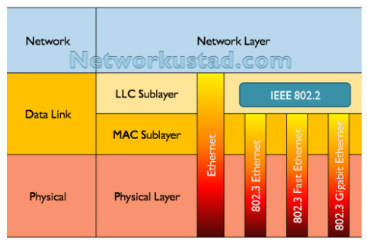
Data link Sub layer

Slide 3
We can consider the data link layer as two sub layers. The upper sub layer is responsible for data link control, and the lower sub layer is responsible for resolving access to the shared media.

Slide 4
Link Types
Point-to-Point(PPP)
Broadcast

Slide 5
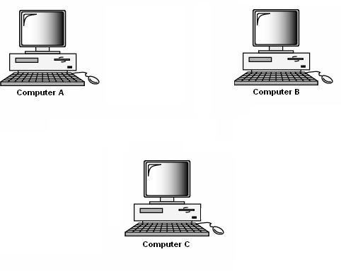
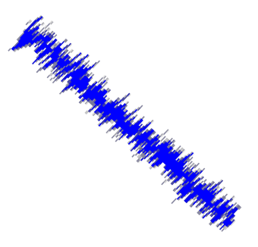
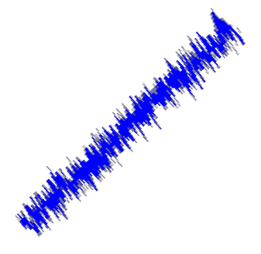
Point-to-point networks
Point-to-point networks are those in which,when a message is sent from
one computer to another, it usually has to be sent via other computers in the network.
PPP for dial-up access
point-to-point link between Ethernet switch and host

Slide 6
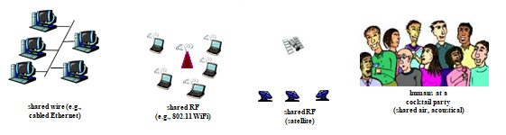
Broadcast (shared wire or medium)
old-fashioned Ethernet
802.11 wireless LAN

Slide 7


Broadcast networks
Broadcast networks have a single communication channel that is shared by all the machines on the network.
Shared channel

Slide 8
Why Multiple Access Protocol ?
If there is a dedicated link between the sender and the receiver then data link control layer is sufficient. How ever if there is no dedicated link present then multiple stations can access the channel simultaneously. This leads to collision.
Hence multiple access protocols are required to decrease collision and avoid crosstalk.

Slide 9
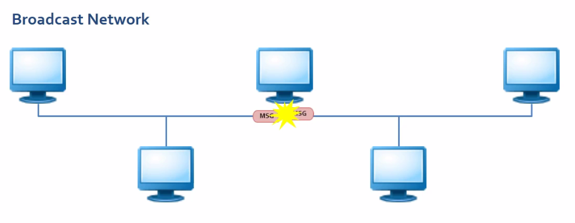
Medium Access Control
if two or more devices are sending data at the same time with out checking the status of the channel status weather the channel is busy or idle the data will collide with each other and become unusable

Slide 10
Multiple Access protocols
distributed algorithm that determines how nodes share channel, i.e., determine when node can transmit
communication about channel sharing must use channel itself!
no out-of-band channel for coordination

Slide 11
If more than one station attempts to send at the same time there is an access conflict/collision and frames are either destroyed/lost/or modified.

Slide 12
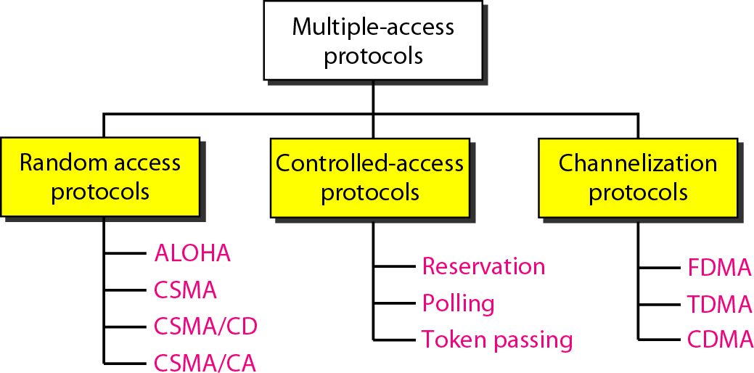
Types of Multiple –access protocol

Slide 13
Random Access
All stations have same superiority that is no station has more priority than another station.
No station is superior.
Each station has the right to the medium with out being controlled by any other station. No station assigned control over another
No station does permit/not permit another station to send.
The decision is based on the state of the medium . Any station can send data depending on medium’s state( idle or busy)

Slide 14
Every station transmits whenever it feels like it.
There is no scheduled time for a station to transmit.
Stations compete (contention) on who takes the medium next.
There is no agreement on who transmits next. If more than one station tries to send at the same time there is an access conflict (collision) and that the frames will be either destroyed or modified.

Slide 15
To avoid access conflict , we need to follow a procedure.
Any procedure for multiple access must answer the following questions
WHO is going to use the channel ?
WHEN can the station access the medium?
WHAT can the station do if the medium is busy?
HOW can the station determine the success for failure of the transmission?
WHAT can the station do if there is an access conflict?
For HOW much time the channel is used ?
Examples: ALOHA, CSMA, CSMA/CD

Slide 16
ALOHA
was developed at the University of Hawaii in early 1970.
Is a random access protocol
Designed for a wireless LAN but it is also applicable for shared medium.
In this, multiple stations can transmit data at the same time and can hence lead to collision and data being garbled.
There are two versions of Aloha system which differ with respect to whether or not time is divided up into discrete slots into which all frames must fit.
PURE ALOHA
SLOTTED ALOHA

Slide 17
Pure (unslotted) ALOHA
Each station sends a frame whenever it has a frame to send.
Since there is only one channel, there is a
possibility of collisions.
simpler, no synchronization

Slide 18
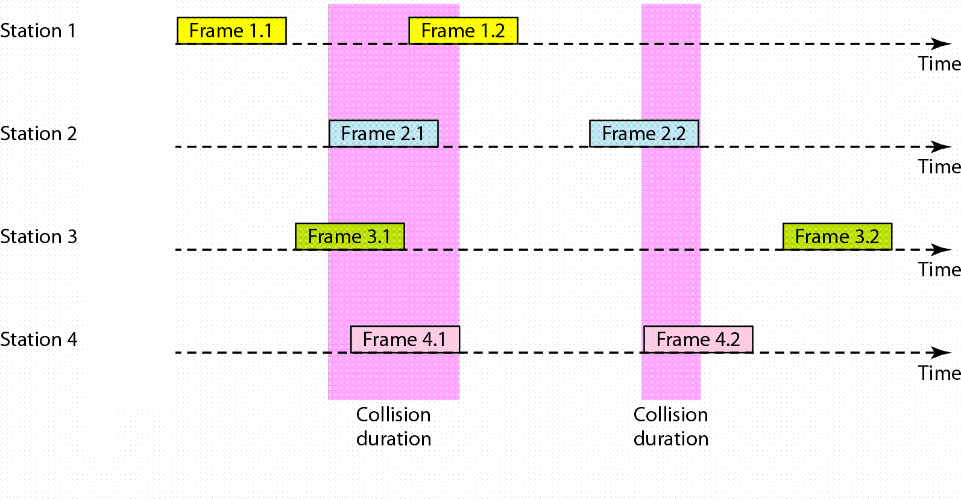



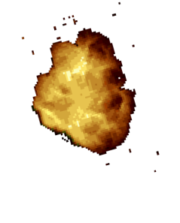
Pure Aloha
Notes:
In the figure above, there are 4 stations. Each station sends two frames, making 8 frames total on one medium.
Some of these frames collide. The above figure shows that only two frames survive.

Slide 19
Pure ALOHA allows the stations to transmit whenever they have the data to be sent.
Pure ALOHA did not have a restriction on when stations can send. This means that stations could start spamming, sending just after/before another station has finished sending stuff.
Whenever two frames try to occupy the channel at the same time, there will be a collision and both will be garbled.
If the first bit of the frame overlaps with just the last bit of a frame almost finished, both frames will be totally destroyed and both will have to be retransmitted later.

Slide 20
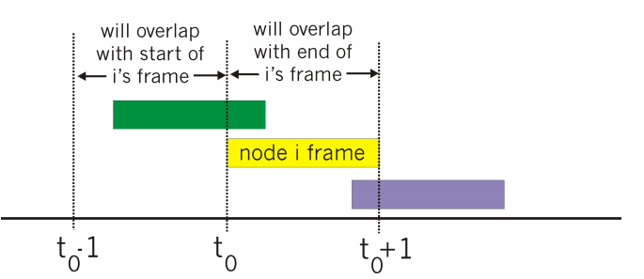
collision probability: frame sent at t0 collides with other frames sent in [t0-1,t0 ]

Slide 21
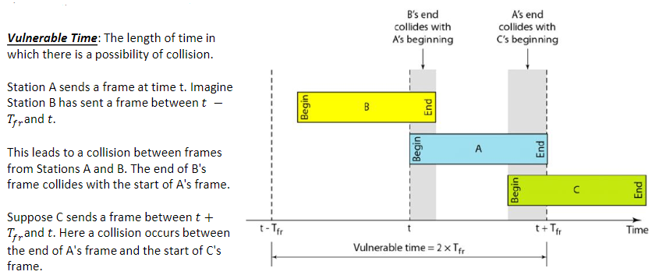
Vulnerable time for ALOHA protocol
frame transmission time (T_{fr})

Slide 22
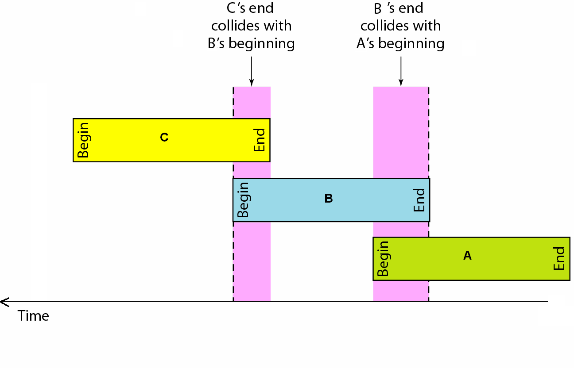
If the first bit of a new frame overlaps with just the last bit of a frame almost finished, both the frames will be totally destroyed. It does not distinguish between a total loss or a near miss.

Slide 23
When a station sends data it waits for an ACK.
If the ACK does not arrive in a specific time period, then the sender just re-sends the frame.
Problem: If two stations re-send frames at the exact same times on the same medium, both frames will be lost. (Hello Race Condition!)
Solution: Pure ALOHA dictates that a sender, upon failing to get an ACK (ACK timed out), will wait a random amount of time before re-sending the frame. This is the back-off time,T_{B}

Slide 24
Since different stations wait for different amount of time, the probability of further collision decreases.
What if the channel is really crappy and it gets filled with re-sends? This creates congestion.
Pure ALOHA prevents congesting the channel with re-transmitted frames.
After a maximum number of re-transmission attempts (K_{max}), a station must give up and try again later.
The throughput of pure aloha is maximized when frames are of uniform length.

Slide 25
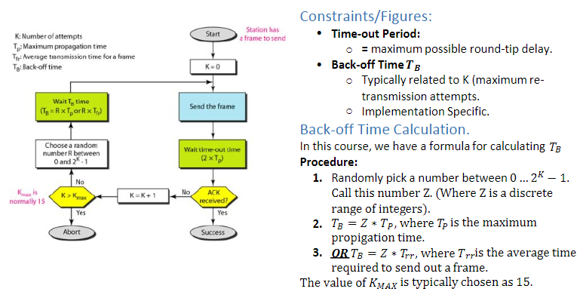
Procedure for Pure ALOHA Protocol

Slide 26
Vulnerable Time=2*T_{tr}
Throughput= G*e^{-2g} ;where G is the number of stations wish to transmit at the same time.
The maximum throughput=0.184 for G=0.5(1/2)

Slide 27
Slotted ALOHA
It was developed to just improve the efficiency of pure aloha as the chances for collision in pure aloha are high.
The time of the shared channel is divided in to discrete time intervals called slots of size frame transmission time (T_{fr}), each corresponding to one packet.
These timeslots are agreed upon by all stations.
all frames same size
nodes are synchronized
sending of data is allowed only at the beginning of the timeslot.

Slide 28
Slotted ALOHA
if 2 or more nodes transmit in same slot, all nodes detect collision operation:
when node obtains fresh frame, transmits in next slot
if no collision: node can send new frame in next slot
if collision: node retransmits frame in each subsequent slot with prob= p until success

Slide 29
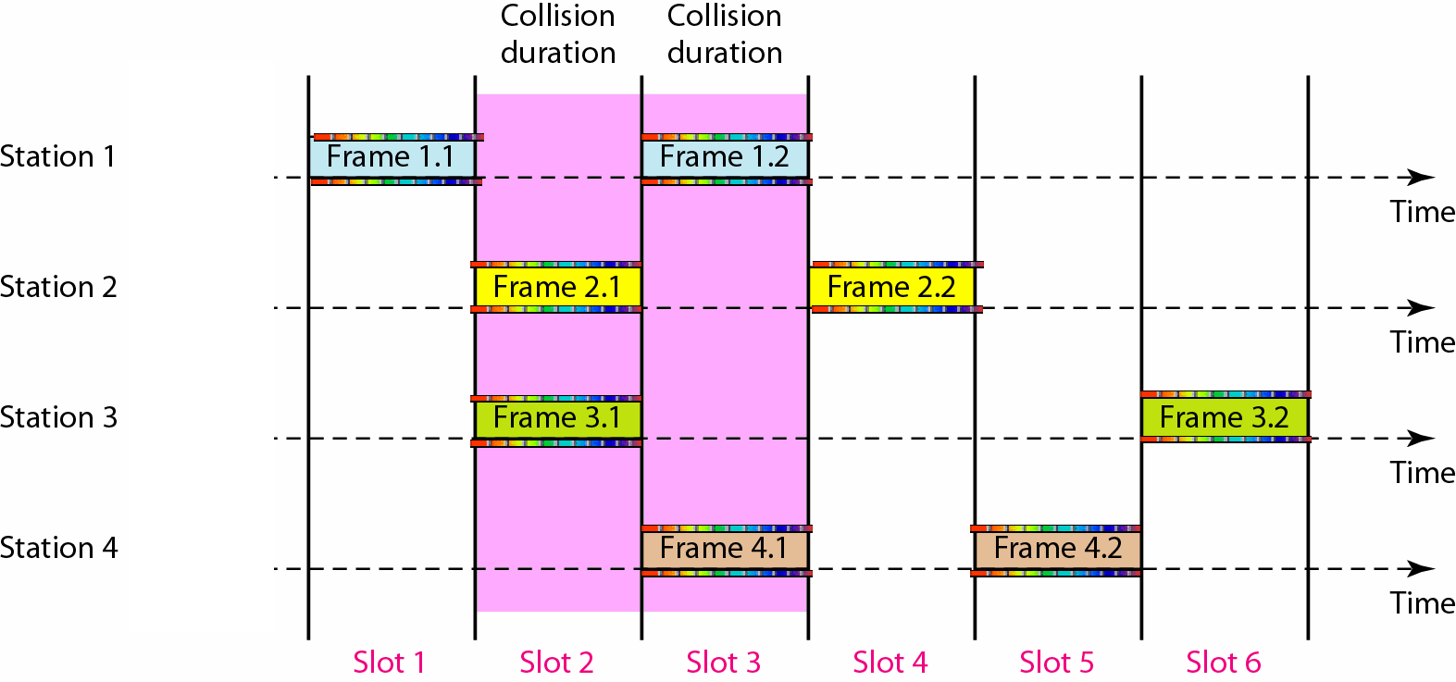

Slide 30
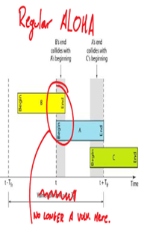

A station is allowed to send at the beginning of a time slot. If it misses the start of the slot, it must wait until the beginning of the next time slot. This reduces the probability of collision.
This implies the station which started at the beginning of the time slot has already finished sending the frame.
This means that we no longer have a vulnerability as shown

Slide 31
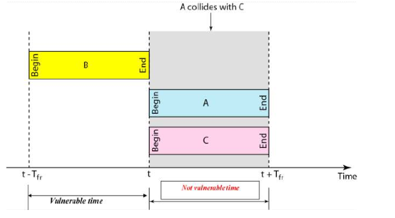
Vulnerable time for slotted ALOHA protocol

Slide 32
Vulnerable Time=T_{tr}
Throughput= G*e^{-G} ;where G is the number of stations wish to transmit at the same time.
The maximum throughput=0.368 for G=1

Slide 33
Pros:
single active node can continuously transmit at full rate of channel
highly decentralized: only slots in nodes need to be in sync
simple
Cons:
collisions, wasting slots
idle slots
nodes may be able to detect collision in less than time to transmit packet
clock synchronization

Slide 34
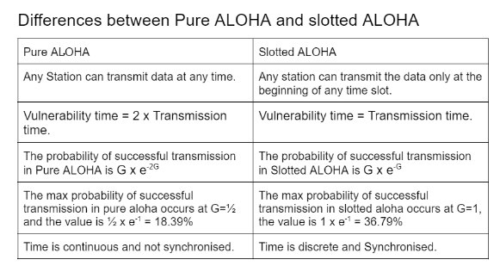

Slide 35
Carrier Sense Multiple Access(CSMA)
The chance of collision can be reduced if a station senses the medium(Carrier) before trying to use it.
Principle of CSMA:
Each station first listen to the medium (aka: check the state) before sending
"Sense before transmit" or "Listen before talk“
Carrier busy=Transmission is taking place
Carrier idle=no transmission currently taking place.
CSMA can reduce possibility of collision, but not eliminate it.

Slide 36
The possibility of collision still exists because of propagation delay. When a station sends a frame, it still takes time for the first bit to reach every station and for every station to sense it.
A station may sense the medium and find it idle, only because the first bit sent by another station had not been received (due to propagation delay)

Slide 37
Types of CSMA
1-Persistent CSMA
P-Persistent CSMA
Non-Persistent CSMA
o-Persistent CSMA
The modified version
CSMA/CD( CSMA with Collision Detection)
CSMA/Ca( CSMA with Collision Avoidance)

Slide 38
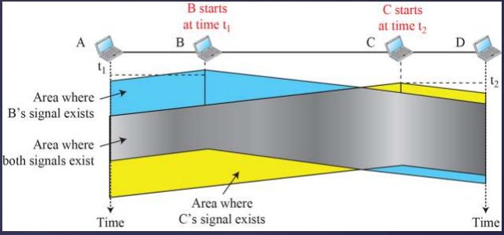
at time T1, station B senses the medium and finds it idle, so it sends a frame.
At time T2 > T1, station C senses the
medium and finds it idle, because at time T2, the first bits from station B haven't made it to station C.
Both stations have sent a frame at the "same-enough" time. Both frames are destroyed.

Slide 39
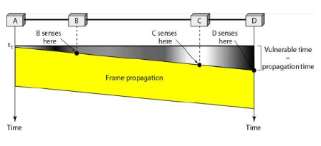
Vulnerable Time in CSMA

Slide 40
Carrier sense multiple access with collision detection(CSMA/CD)
If two stations sense the channel to be idle and begin transmitting simultaneously, they will detect the collision almost immediately.
Rather than finish transmitting their frames, which are irretrievably garbled anyway, they should abruptly stop transmitting as soon ad the collision is detected.
Quickly terminating damaged frames saves time and bandwidth.
Is widely used on LANs in the MAC sub layer.
Access method used by Ethernet: CSMA/CD

Slide 41
At time point marked t0, a station has finished transmitting its frame.
Any other station having a frame to send may now attempt to do so. If two or more stations decide to transmit simultaneously, there will be a collision.
Collision can be detected by looking at the power of pulse width of the received signal and comparing it to the transmitted signal.

Slide 42
After the station detects a collision, it aborts its transmission, waits a random period of time, and then tries again, assuming that no other station has started transmitting in the meantime.
Therefore, model for CSMA/CD will consist of alternating contention and transmission periods, with idle periods occurring when all stations are quiet.

Slide 43
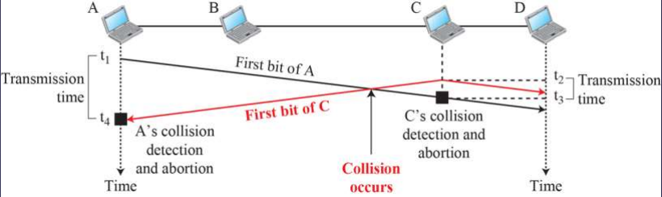
Collision of the first bits in CSMA/CD
at time t1 A starts sending bits of the frame
At time t2, C hasn't sensed the first bits from A.
C starts sending bits, which go left and right.
Sometime after t2, a collision occurs.
At time t3, C detects a collision when it received part of A's frame.
(Sending things…. Oh shit! We have some of A's frame before mine should get anywhere!)
C immediately stops transmission.
A detects collision at time t4 when it gets part of C's frame. A immediately aborts transmission.
We see that
A was spamming for time t4 – t1
A.C was spamming for time t3 - t2

Slide 44
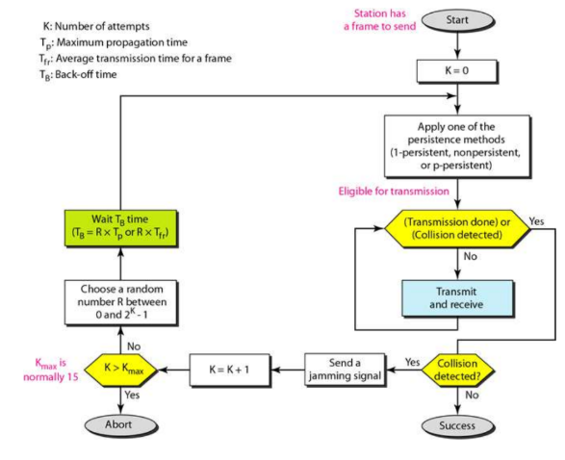
Flow Diagram for CSMA/CD
ALOHA: first send entire frame, then wait for ACK
CSMA/CD: send and detect simultaneously. No ACK is needed.

Slide 45
Carrier sense multiple access with collision avoidance(CSMA/CA)
Is a multiple access method in which carrier sensing is used, but nodes attempting to avoid collisions by beginning transmission only after the channel is sensed to be “idle”.
It is particularly important for wireless networks, where the collision detection for the alternative CSMA/CD is not possible due to wireless transmission desensing their receivers during packet transmission.
In a wireless network, the received signal has very little energy due to energy loss in transmission → a collision may add only 5~10% additional energy → not useful for effective collision detection

Slide 46
CSMA/CA is unreliable due to the hidden node problem and exposed terminal problem.
Soltion: RTS/CTS exchange Features
Operates at the data link layer (layer 2) of the OSI model
used in 802.11 wi-fi

Slide 47
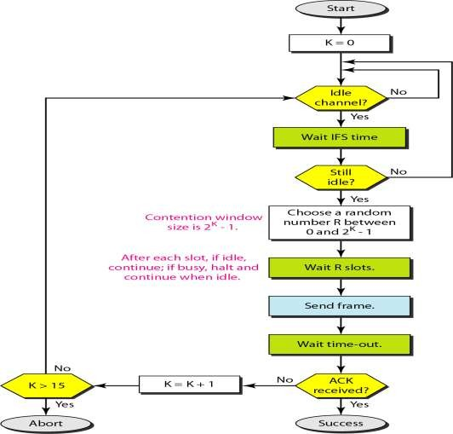
Flow Diagram for CSMA/CA
1-persistent

Slide 48
Controlled-Access Protocols
In controlled access, the stations consult on another to find which station has the right to send.
A station cannot send unless it has been authorized by other stations.
Controlled access methods
Reservation
Ex. DQDB, Cable modem, …
Polling
Select and Poll
Ex. HDLC (normal response mode)
Token passing
Ex. Token ring (FDDI), token bus, …

Slide 49
Reservation
A station need to make a reservation before sending data.
Time is divided into intervals
In each interval, a reservation frame precedes the data frames sent in that interval.
If there are N stations in the system, there are exactly N reservation mini slots in the reservation frame
Each minislot belongs to a station

Slide 50
When a station needs to send a data frame it makes a reservation in its own minislot
Stations that have made reservation can send their data frames.

Slide 51
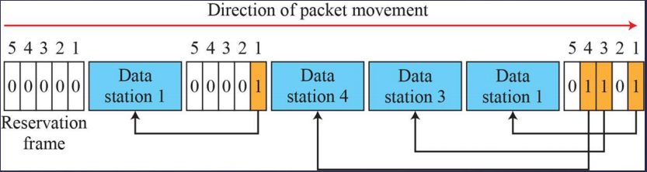
In the diagram above, 5 stations, 5 minislot reservation frame
At first interval,
Only stations 1,3,4 have made reservation.
In second interval,
only station 1 has made a reservation

Slide 52
Pooling
Requires one of the nodes to be designated as a primary station ( Master node) , and the others are secondary stations.
The master node polls each of the nodes in a round-robin fashion.
All data exchanges must be made through the primary device even when the ultimate destination is a secondary device.
The primary device controls the link, the secondary devices follow its instructions.
It is up to the primary device to determine which device is allowed to use the channel at a given time.
The primary device, therefore, is always the initiator of a session

Slide 53
The master node first sends a message to node 1, saying that it can transmit up to some maximum number of frames.
After node 1 transmits some frames, the master node 2 can transmits some frames to the maximum number of frames.
The master node can determine when the nodes has finished sending its frame by observing the lack of a signal on the channel.

Slide 54
The procedure continues in the manner, with the master node pooling each of the nodes in a cyclic manner.
Eliminates collision
This allows polling to achieve a much higher efficiency

Slide 55
drawback
The protocol introduces a pooling delay-the amount of time required to notify a node that it can transmit.
If the master node fails, the transmit entire channel becomes inoperative.

Slide 56
Pooling –Functions
If the primary wants to receive data, ask the secondary's if they have anything to send poll function
If the primary wants to send data, tells the secondary's to get ready to receive --> select function.
Select
The primary alerts a secondary that data is coming.
Needs an ACK from the secondary so that the receiver is ready. (The ACK is in response to a SEL frame).
SEL is like "YOU'RE GONNA GET DATA WHEN YOU'RE READY. YOU READY BRO?"
POOL
Primary asks everyone in turn if they have something to send. If NAK, then ask the next station

Slide 57
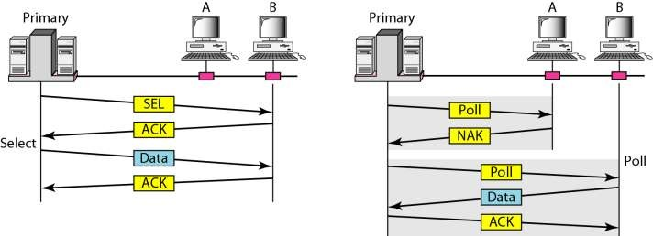

Slide 58
Efficiency of pooling
Let T_{poll} be the time for polling and T_{t} be the time required for transmission of data. Than
Efficiency=T_{i}/(T_{t}+T_{poll})

Slide 59
Token Passing
A station is authorized to send data when it receives a special frame called a token
Here there is no mater node
A small, special-purpose frame known as a token is exchanged among the nodes in some fixed order
Stations are arranged around a ring (physically or logically)
A token circulates around the ring
When a node receives a token, it holds onto the token only if it has some frames to transmit; otherwise, it immediately forwards the token to the next node.

Slide 60
If the node have frames to transmit
it waits for the token.
The station captures the token and sends one or more frames as long as the allocated time has not expired.
It releases the token to be used by the successor station.

Slide 61
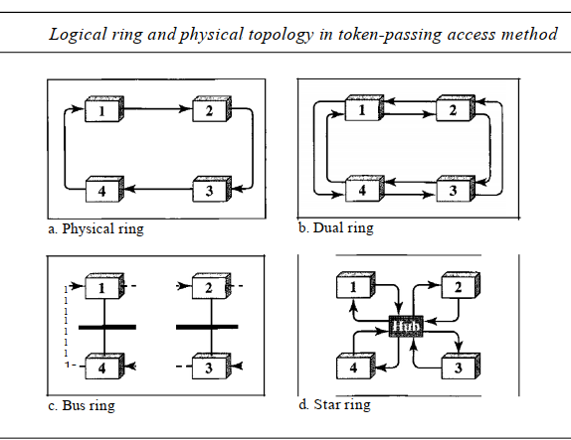

Slide 62
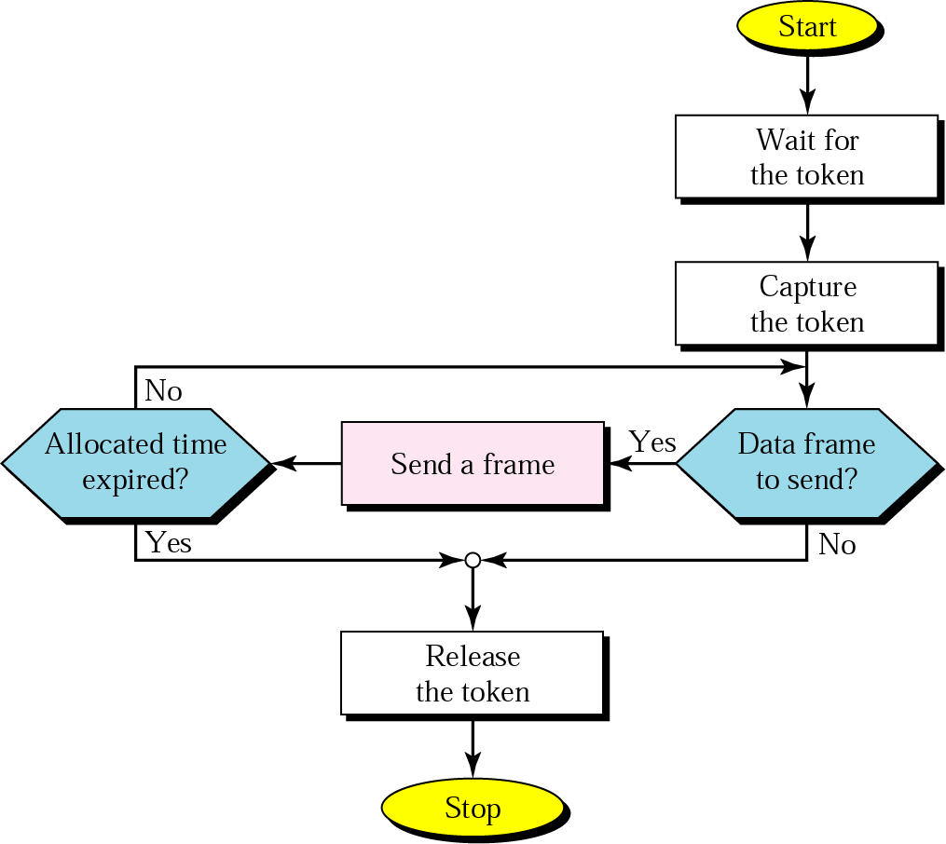
Procedure

Slide 63
Token passing is decentralized and highly efficient. but it has problems as well.
For example, the failure of one node can crash the entire channel. Or if node accidentally neglects to release the token, then some recovery procedure must be invoked to get the token back in circulation

Slide 64
Fixed Assignment /Channelization
A Multiple-access method in which the available BW of a link is shared in time, frequency, or through code, between different stations.
Allocate the channel in a static manner. This allocation scheme doesn’t depend on the demands of the nodes

Slide 65
Multiplexing
Multiplexing in a computer networking means multiple signals are combined together thus travel simultaneously in a shared medium.
Multiplexing= sahring the bandwidth
Types
Frequency Division Multiplexing(FDMA)
Time Division Multiplexing(TDMA)
Code division Multiplexing (CDMA)
Features
FDMA, TDMA are based on FDM and TDM in the physical layer
CDMA is a data link multiple-access protocol

Slide 66
Frequency-Division Multiple Access (FDMA)
A data link layer protocol that uses FDM at the physical layer
The available BW of the common channel is divided into bands that are separated by guard bands.
The available bandwidth is shared by all stations.
Each stations uses its allocated band to send its data
To prevent station interferences, the allocated bands are separated from one another by small guard bands. Ex. AMPS (1G cellular networks)

Slide 67
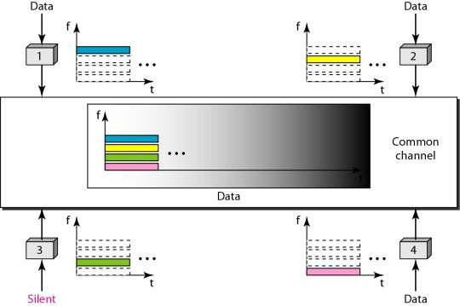

Slide 68
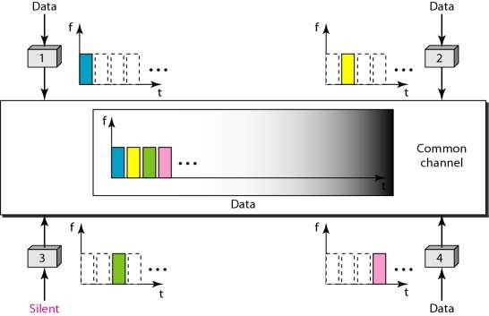
Time-Division Multiple Access (TDMA)
A data link layer protocol that uses TDM at the physical layer
The stations share the capacity of the channel in time
The entire bandwidth is just one channel
Each station is allocated a time slot during which it can send data
Ex. GSM (2G cellular networks - Europe)

Slide 69
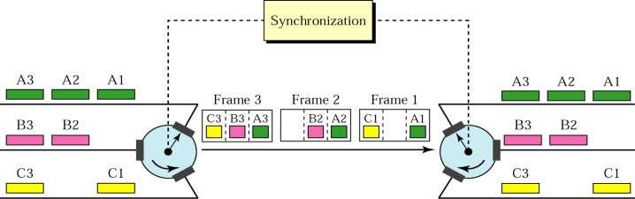
The main problem with TDMA lies in achieving synchronization between the different stations. Each station needs to know the beginning of its slot and the location of its slot. This may be difficult because of propagation delays introduced in the system if the stations are spread over a large area. To compensate for the delays, we can insert guard times. Synchronization is normally accomplished by having some synchronization bits normally refined to as preamble bits) at the beginning of each slot.

Slide 70
Code Division Multiple Access (CDMA)
In CDMA, one channel carries all the transmissions simultaneously.
It differs from FDMA because only one channel occupies the entire bandwidth of the link
It differs from FDMA because all the stations can send data simultaneously there is no time sharing.
used in several wireless broadcast channels (cellular, satellite, etc) standards
unique “code” assigned to each user; i.e., code set partitioning

Slide 71
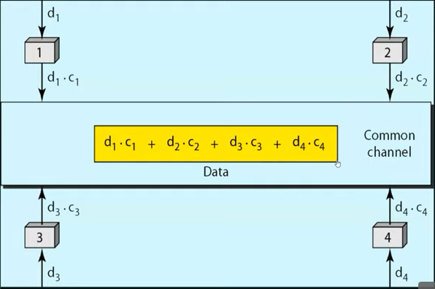

Slide 72
The assigned code have two properties
If we multiply each code by another we get 0
If we multiply each code by itself, we get 4 (the number of stations)
Example
Data=(d₁c₁+d₂c₂+d₃c₃+d₄c₄

